Slide 1




Databases
Database Connection Methods
SoftUni Team
Technical Trainers
Software University
http://softuni.bg

Slide 2

Table of Contents
What are Flat Files?
Working with Flat Files
What is XML?
Processing XML Files
What is DataSet?
Working with DataSet

Slide 3
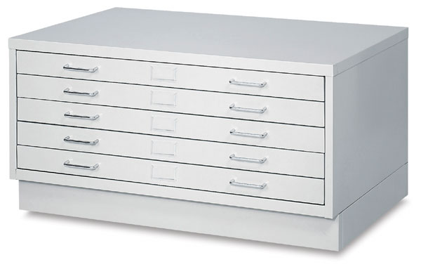
Flat Files

Slide 4
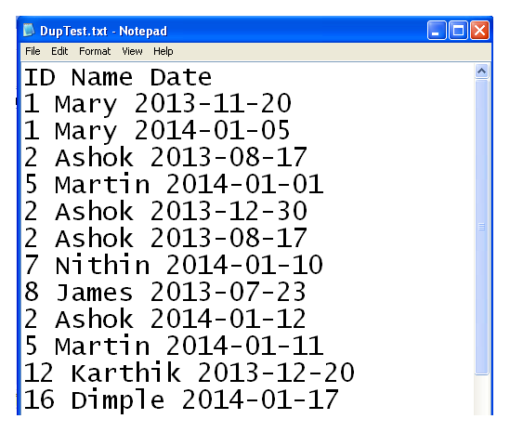
Flat Files
A Flat file is a database which is stored on its host computer system as an ordinary unstructured file
A flat file usually contains one row of data per line
The columns are separated by delimiters such as commas or have a fixed length

Slide 5

Working with Text (Flat) files

Slide 6
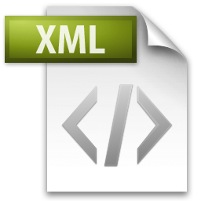
Extensible Markup Language (XML)

Slide 7
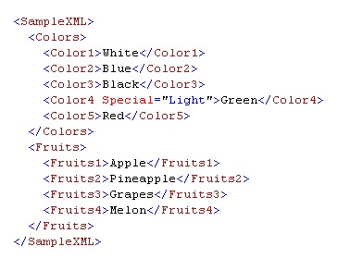
XML
Extensible Markup Language (XML) is a text-based format for representing structured data
In XML, you can store both data and metadata
XML consists of tags (contained within angle brackets) and data

Slide 8
Processing XML Files
There are many ways in which you can work with XML data
In C# the classes that work with XML data are organized in the System.Xml namespace
XmlReader and XmlWriter
Provide fast, non-cached, forward-only way to read or write XML data
XmlDocument
Allows navigation and editing of XML data over an XML document

Slide 9

Working with XML files

Slide 10
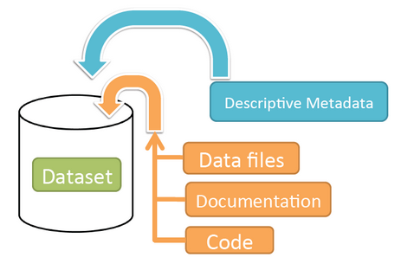
DataSet

Slide 11
DataSet
A DataSet is an in-memory representation of relational data.
A DataSet:
is an in-memory representation of relational data
is usually created by retrieving data from a data source such as a database
can have tables, relations, and data-integrity constraints such as unique constraints or foreign key constraints, just like a Database

Slide 12


Working with an In-Memory DataSet Object

Slide 13

Summary
What are Flat files?
How to use them?
What is XML?
How to read XML data from XML files?
How to write XML data to XML files?
What are DataSets?
What are they useful for?
How to work with them?

Slide 14








Questions
https://softuni.bg/courses/javascript-applications/

